Slide 1
Advanced Data Structures
September 14, 2016

Slide 2
Binary Search Tree
Searching a key
Inserting a key
Deleting a key
Sorting Algorithms
Selection Sort
Insertion Sort
Bubble Sort
Merge Sort
Quick Sort
Heap
Max Heap Construction
Max Heap Deletion
Graph
Breadth First Traversal
Depth First Traversal

Slide 3
Objectives
Learning Advance Data structures including-
Binary Search Tree
Sorting Algorithms
Heap
Graph

Slide 4
Binary Search Tree (BST)

Slide 5
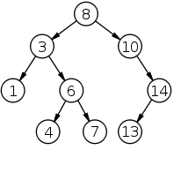
Binary Search Tree (BST)
Binary Search Tree, is a node-based binary tree data structure which has the following properties:
The left subtree of a node contains only nodes with keys less than the node’s key.
The right subtree of a node contains only nodes with keys greater than the node’s key.
The left and right subtree each must also be a binary search tree.
There must be no duplicate nodes.
The above properties of Binary Search Tree provide an ordering among keys so that the operations like search, minimum and maximum can be done fast. If there is no ordering, then we may have to compare every key to search a given key.

Slide 6
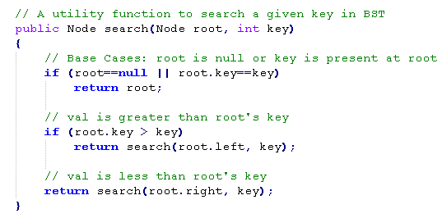
BST - Searching a key
To search a given key in Bianry Search Tree, we first compare it with root, if the key is present at root, we return root. If key is greater than root’s key, we recur for right subtree of root node. Otherwise we recur for left subtree.

Slide 7
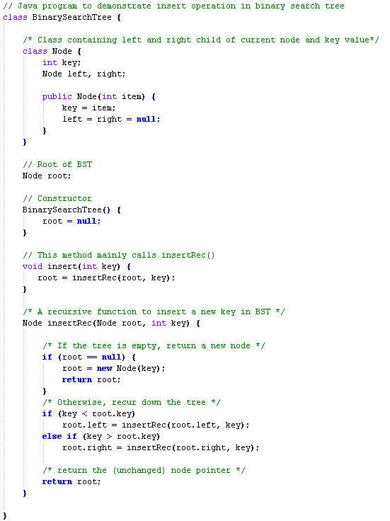
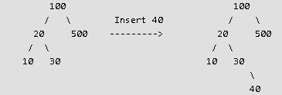
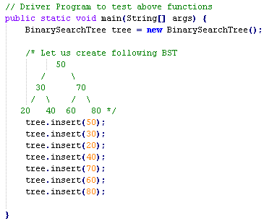
BST – Inserting a key
A new key is always inserted at leaf. We start searching a key from root till we hit a leaf node. Once a leaf node is found, the new node is added as a child of the leaf node.

Slide 8



BST – Deleting a key
When we delete a node, there possibilities arise.
Node to be deleted is leaf: Simply remove from the tree.
Node to be deleted has only one child: Copy the child to the node and delete the child
Node to be deleted has two children: Find inorder successor of the node. Copy contents of the inorder successor to the node and delete the inorder successor. Note that inorder predecessor can also be used.
The important thing to note is, inorder successor is needed only when right child is not empty. In this particular case, inorder successor can be obtained by finding the minimum value in right child of the node.

Slide 9
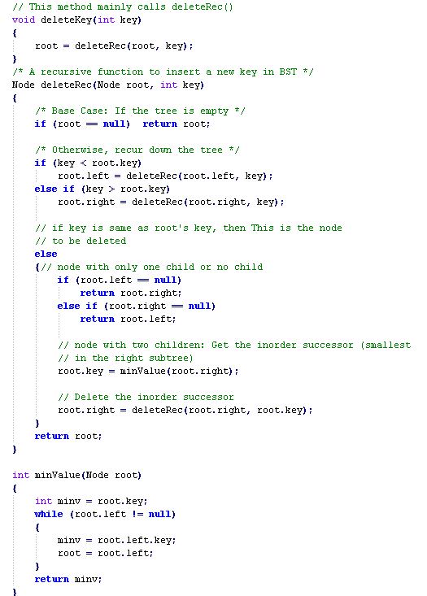
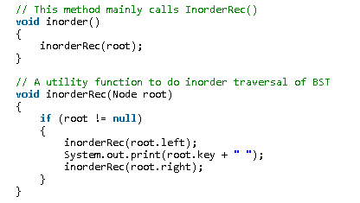
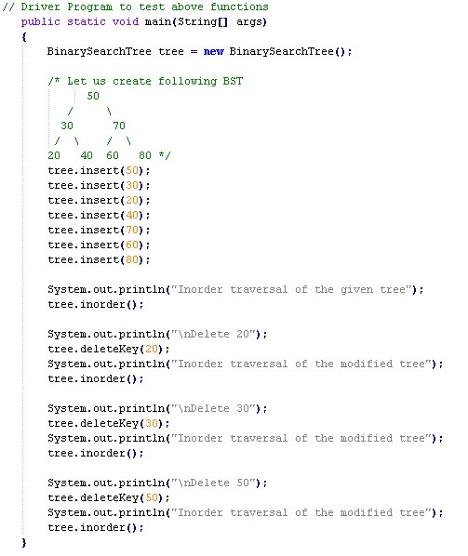

Slide 10
Sorting

Slide 11
Sorting
Sorting is a process that organizes a collection of data into either ascending or descending order.
An internal sort requires that the collection of data fit entirely in the computer’s main memory.
We can use an external sort when the collection of data cannot fit in the computer’s main memory all at once but must reside in secondary storage such as on a disk.
We will analyze only internal sorting algorithms.
Any significant amount of computer output is generally arranged in some sorted order so that it can be interpreted.
Sorting also has indirect uses. An initial sort of the data can significantly enhance the performance of an algorithm.
Majority of programming projects use a sort somewhere, and in many cases, the sorting cost determines the running time.
A comparison-based sorting algorithm makes ordering decisions only on the basis of comparisons.

Slide 12
Sorting Algorithms
There are many sorting algorithms, such as:
Selection Sort
Insertion Sort
Bubble Sort
Merge Sort
Quick Sort
The first three are the foundations for faster and more efficient algorithms.

Slide 13
Selection Sort
The list is divided into two sublists, sorted and unsorted, which are divided by an imaginary wall.
We find the smallest element from the unsorted sublist and swap it with the element at the beginning of the unsorted data.
After each selection and swapping, the imaginary wall between the two sublists move one element ahead, increasing the number of sorted elements and decreasing the number of unsorted ones.
Each time we move one element from the unsorted sublist to the sorted sublist, we say that we have completed a sort pass.
A list of n elements requires n-1 passes to completely rearrange the data.

Slide 14
Sorted
Unsorted
23 | 78 | 45 | 8 | 32 | 56
8 | 78 | 45 | 23 | 32 | 56
8 | 23 | 45 | 78 | 32 | 56
8 | 23 | 32 | 78 | 45 | 56
8 | 23 | 32 | 45 | 78 | 56
8 | 23 | 32 | 45 | 56 | 78
Original List
After pass 1
After pass 2
After pass 3
After pass 4
After pass 5

Slide 15
Selection Sort (cont.)
template <class Item>
void selectionSort( Item a[], int n) {
for (int i = 0; i < n-1; i++) {
int min = i;
for (int j = i+1; j < n; j++)
if (a[j] < a[min]) min = j;
swap(a[i], a[min]);
}
}
template < class Object>
void swap( Object &lhs, Object &rhs )
{
Object tmp = lhs;
lhs = rhs;
rhs = tmp;
}

Slide 16
Selection Sort -- Analysis
In general, we compare keys and move items (or exchange items) in a sorting algorithm (which uses key comparisons).
➔ So, to analyze a sorting algorithm we should count the number of key comparisons and the number of moves.
Ignoring other operations does not affect our final result.
In selectionSort function, the outer for loop executes n-1 times.
We invoke swap function once at each iteration.
➔ Total Swaps: n-1
➔ Total Moves: 3*(n-1) (Each swap has three moves)

Slide 17
Selection Sort – Analysis (cont.)
The inner for loop executes the size of the unsorted part minus 1 (from 1 to n-1), and in each iteration we make one key comparison.
➔ # of key comparisons = 1+2+...+n-1 = n*(n-1)/2
➔ So, Selection sort is O(n²)
The best case, the worst case, and the average case of the selection sort algorithm are same. ➔ all of them are O(n²)
This means that the behavior of the selection sort algorithm does not depend on the initial organization of data.
Since O(n²) grows so rapidly, the selection sort algorithm is appropriate only for small n.
Although the selection sort algorithm requires O(n²) key comparisons, it only requires O(n) moves.
A selection sort could be a good choice if data moves are costly but key comparisons are not costly (short keys, long records).

Slide 18
Insertion Sort
Insertion sort is a simple sorting algorithm that is appropriate for small inputs.
Most common sorting technique used by card players.
The list is divided into two parts: sorted and unsorted.
In each pass, the first element of the unsorted part is picked up, transferred to the sorted sublist, and inserted at the appropriate place.
A list of n elements will take at most n-1 passes to sort the data.

Slide 19
Sorted
Unsorted
23 | 78 | 45 | 8 | 32 | 56
23 | 78 | 45 | 8 | 32 | 56
23 | 45 | 78 | 8 | 32 | 56
8 | 23 | 45 | 78 | 32 | 56
8 | 23 | 32 | 45 | 78 | 56
8 | 23 | 32 | 45 | 56 | 78
Original List
After pass 1
After pass 2
After pass 3
After pass 4
After pass 5

Slide 20
Insertion Sort Algorithm
template <class Item>
void insertionSort(Item a[], int n)
{
for (int i = 1; i < n; i++)
{
Item tmp = a[i];
for (int j=i; j>0 && tmp < a[j-1]; j--)
a[j] = a[j-1];
a[j] = tmp;
}
}

Slide 21
Insertion Sort – Analysis
Running time depends on not only the size of the array but also the contents of the array.
Best-case: ➔ O(n)
Array is already sorted in ascending order.
Inner loop will not be executed.
The number of moves: 2*(n-1) ➔ O(n)
The number of key comparisons: (n-1) ➔ O(n)
Worst-case: ➔ O(n²)
Array is in reverse order:
Inner loop is executed i-1 times, for i = 2,3, …, n
The number of moves: 2*(n-1)+(1+2+...+n-1)= 2*(n-1)+ n*(n-1)/2 ➔ O(n²)
The number of key comparisons: (1+2+...+n-1)= n*(n-1)/2 ➔ O(n²)
Average-case: ➔ O(n²)
We have to look at all possible initial data organizations.
So, Insertion Sort is O(n²)

Slide 22
Analysis of insertion sort
Which running time will be used to characterize this algorithm?
Best, worst or average?
Worst:
Longest running time (this is the upper limit for the algorithm)
It is guaranteed that the algorithm will not be worse than this.
Sometimes we are interested in average case. But there are some problems with the average case.
It is difficult to figure out the average case. i.e. what is average input?
Are we going to assume all possible inputs are equally likely?
In fact for most algorithms average case is same as the worst case.

Slide 23
Bubble Sort
The list is divided into two sublists: sorted and unsorted.
The smallest element is bubbled from the unsorted list and moved to the sorted sublist.
After that, the wall moves one element ahead, increasing the number of sorted elements and decreasing the number of unsorted ones.
Each time an element moves from the unsorted part to the sorted part one sort pass is completed.
Given a list of n elements, bubble sort requires up to n-1 passes to sort the data.

Slide 24
Bubble Sort
23 | 78 | 45 | 8 | 32 | 56
8 | 23 | 78 | 45 | 32 | 56
8 | 23 | 32 | 78 | 45 | 56
8 | 23 | 32 | 45 | 78 | 56
8 | 23 | 32 | 45 | 56 | 78
Original List
After pass 1
After pass 2
After pass 3
After pass 4

Slide 25
Bubble Sort Algorithm
template <class Item>
void bubleSort(Item a[], int n)
{
bool sorted = false;
int last = n-1;
for (int i = 0; (i < last) && !sorted; i++){
sorted = true;
for (int j=last; j > i; j--)
if (a[j-1] > a[j]{
swap(a[j],a[j-1]);
sorted = false; // signal exchange
}
}
}

Slide 26
Bubble Sort – Analysis
Best-case: ➔ O(n)
Array is already sorted in ascending order.
The number of moves: 0 ➔ O(1)
The number of key comparisons: (n-1) ➔ O(n)
Worst-case: ➔ O(n²)
Array is in reverse order:
Outer loop is executed n-1 times,
The number of moves: 3*(1+2+...+n-1) = 3 * n*(n-1)/2 ➔ O(n²)
The number of key comparisons: (1+2+...+n-1)= n*(n-1)/2 ➔ O(n²)
Average-case: ➔ O(n²)
We have to look at all possible initial data organizations.
So, Bubble Sort is O(n²)

Slide 27
Mergesort
Mergesort algorithm is one of two important divide-and-conquer sorting algorithms (the other one is quicksort).
It is a recursive algorithm.
Divides the list into halves,
Sort each halve separately, and
Then merge the sorted halves into one sorted array.

Slide 28
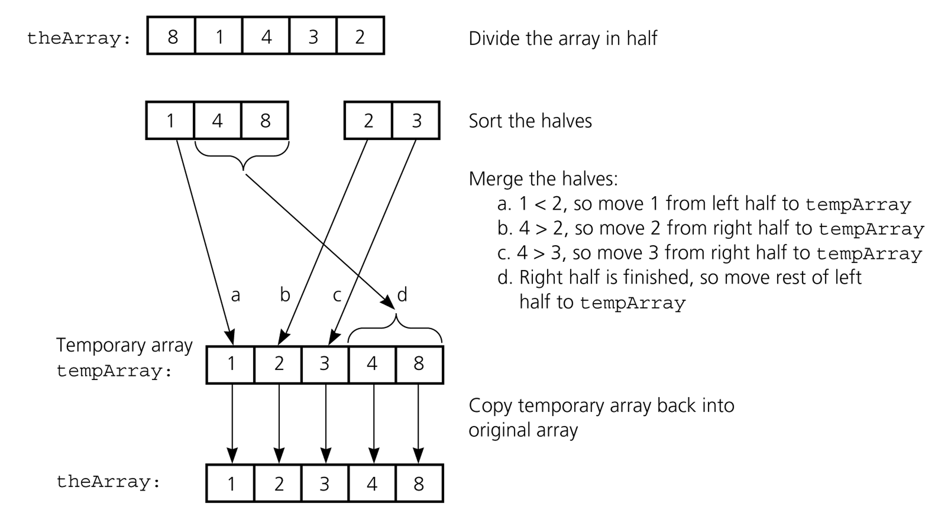
Mergesort - Example

Slide 29
Merge
const int MAX_SIZE = maximum-number-of-items-in-array;
void merge(DataType theArray[], int first, int mid, int last) {
DataType tempArray[MAX_SIZE]; // temporary array
int first1 = first; // beginning of first subarray
int last1 = mid; // end of first subarray
int first2 = mid + 1; // beginning of second subarray
int last2 = last; // end of second subarray
int index = first1; // next available location in tempArray
for ( ; (first1 <= last1) && (first2 <= last2); ++index) {
if (theArray[first1] < theArray[first2]) {
tempArray[index] = theArray[first1];
++first1;
}
else {
tempArray[index] = theArray[first2];
++first2;
} }

Slide 30
Merge (cont.)
// finish off the first subarray, if necessary
for (; first1 <= last1; ++first1, ++index)
tempArray[index] = theArray[first1];
// finish off the second subarray, if necessary
for (; first2 <= last2; ++first2, ++index)
tempArray[index] = theArray[first2];
// copy the result back into the original array
for (index = first; index <= last; ++index)
theArray[index] = tempArray[index];
} // end merge

Slide 31
Mergesort
void mergesort(DataType theArray[], int first, int last) {
if (first < last) {
int mid = (first + last)/2; // index of midpoint
mergesort(theArray, first, mid);
mergesort(theArray, mid+1, last);
// merge the two halves
merge(theArray, first, mid, last);
}
} // end mergesort

Slide 32
Mergesort - Example
6 | 3 | 9 | 1 | 5 | 4 | 7 | 2
divide
6 | 3 | 9 | 1
5 | 4 | 7 | 2
divide
divide
6 | 3
9 | 1
5 | 4
7 | 2
divide
divide
divide
divide
6
3
9
1
5
4
7
2
merge
merge
merge
merge
3 | 6
1 | 9
4 | 5
2 | 7
merge
merge
1 | 3 | 6 | 9
2 | 4 | 5 | 7
merge
1 | 2 | 3 | 4 | 5 | 7 | 8 | 9

Slide 33
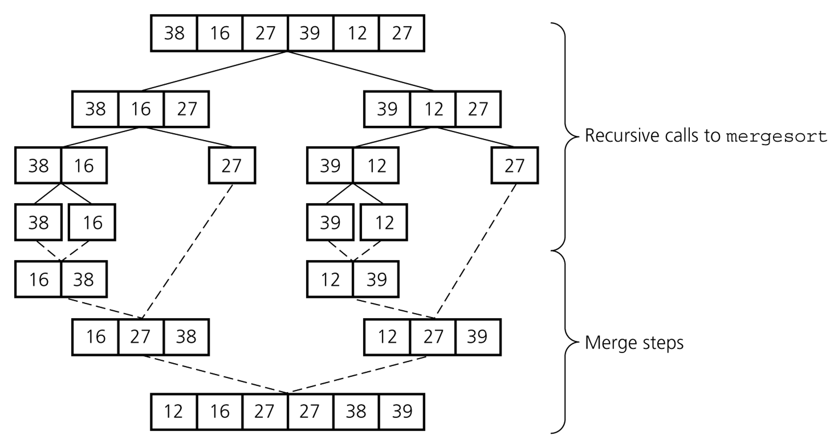
Mergesort – Example2

Slide 34
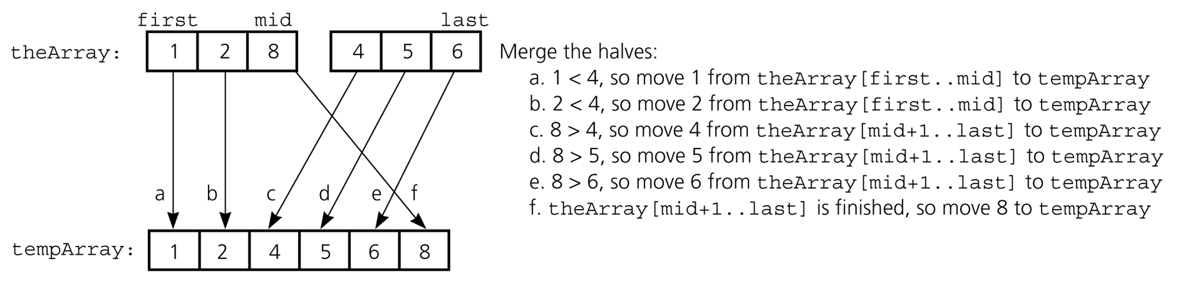
Mergesort – Analysis of Merge
A worst-case instance of the merge step in mergesort

Slide 35
Mergesort – Analysis of Merge (cont.)
0 k-1
0 k-1
Merging two sorted arrays of size k
Best-case:
All the elements in the first array are smaller (or larger) than all the elements in the second array.
The number of moves: 2k + 2k
The number of key comparisons: k
Worst-case:
The number of moves: 2k + 2k
The number of key comparisons: 2k-1
 | ......
 | ......
0 2k-1
 | ......

Slide 36
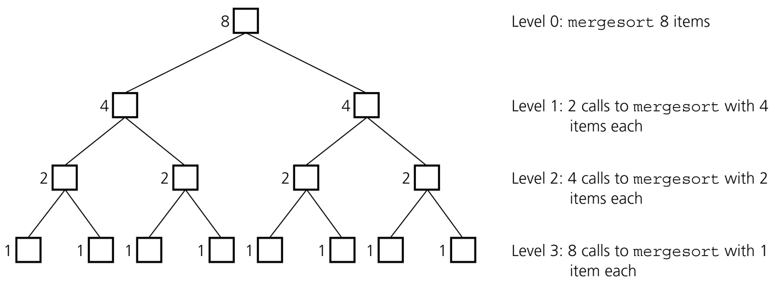
Mergesort - Analysis
Levels of recursive calls to mergesort, given an array of eight items

Slide 37
Mergesort - Analysis
2^{m}
level 0 : 1 merge (size 2^{m-1})
2^{m-1}
2^{m-1}
level 1 : 2 merges (size 2^{m-2})
level 2 : 4 merges (size 2^{m-3})
2^{m-2}
2^{m-2}
2^{m-2}
2^{m-2}
.
.
.
.
.
.
level m-1 : 2^{m-1} merges (size 2⁰)
2⁰
2⁰
. . . . . . . . . . . . . . . . .
level m

Slide 38
Mergesort - Analysis
Worst-case –
The number of key comparisons:
= 2⁰*(2*2^{m-1}-1) + 2¹*(2*2^{m-2}-1) + ... + 2^{m-1}*(2*2⁰-1)
= (2^{m} - 1) + (2^{m} - 2) + ... + (2^{m} – 2^{m-1}) ( m terms )
= m*2^{m} –
= m*2^{m} – 2^{m} – 1
Using m = log n
= n * log₂n – n – 1
➔ O (n * log₂n )

Slide 39
Mergesort – Analysis
Mergesort is extremely efficient algorithm with respect to time.
Both worst case and average cases are O (n * log₂n )
But, mergesort requires an extra array whose size equals to the size of the original array.
If we use a linked list, we do not need an extra array
But, we need space for the links
And, it will be difficult to divide the list into half ( O(n) )

Slide 40
Quicksort
Like mergesort, Quicksort is also based on
the divide-and-conquer paradigm.
But it uses this technique in a somewhat opposite manner,
as all the hard work is done before the recursive calls.
It works as follows:
First, it partitions an array into two parts,
Then, it sorts the parts independently,
Finally, it combines the sorted subsequences by
a simple concatenation.

Slide 41
Quicksort (cont.)
The quick-sort algorithm consists of the following three steps:
1. Divide: Partition the list.
To partition the list, we first choose some element from the list for which we hope about half the elements will come before and half after. Call this element the pivot.
Then we partition the elements so that all those with values less than the pivot come in one sublist and all those with greater values come in another.
2. Recursion: Recursively sort the sublists separately.
3. Conquer: Put the sorted sublists together.

Slide 42
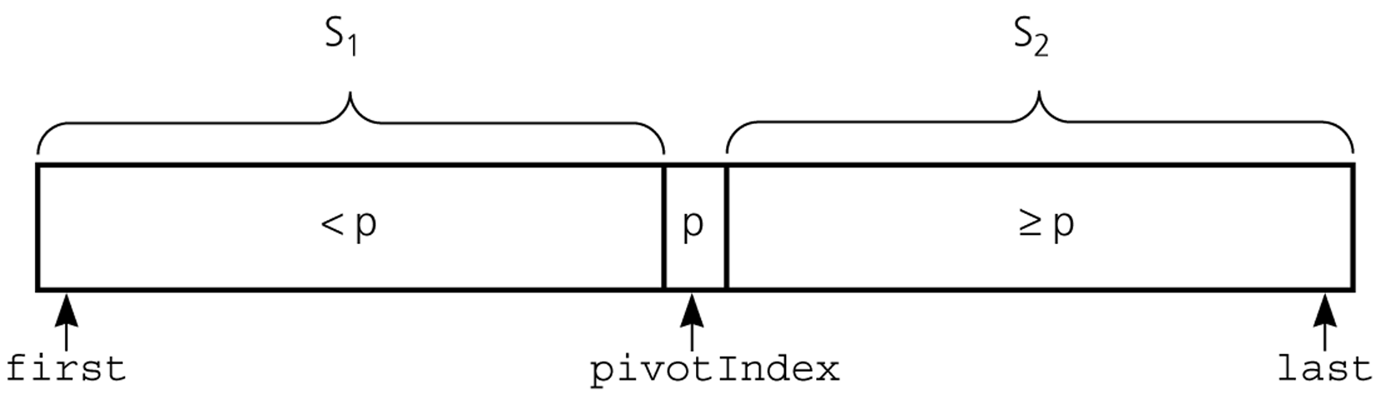
Partition
Partitioning places the pivot in its correct place position within the array.
Arranging the array elements around the pivot p generates two smaller sorting problems.
sort the left section of the array, and sort the right section of the array.
when these two smaller sorting problems are solved recursively, our bigger sorting problem is solved.

Slide 43
Partition – Choosing the pivot
First, we have to select a pivot element among the elements of the given array, and we put this pivot into the first location of the array before partitioning.
Which array item should be selected as pivot?
Somehow we have to select a pivot, and we hope that we will get a good partitioning.
If the items in the array arranged randomly, we choose a pivot randomly.
We can choose the first or last element as a pivot (it may not give a good partitioning).
We can use different techniques to select the pivot.

Slide 44
Partition Function
template <class DataType>
void partition(DataType theArray[], int first, int last,
int &pivotIndex) {
// Partitions an array for quicksort.
// Precondition: first <= last.
// Postcondition: Partitions theArray[first..last] such that:
// S1 = theArray[first..pivotIndex-1] < pivot
// theArray[pivotIndex] == pivot
// S2 = theArray[pivotIndex+1..last] >= pivot
// Calls: choosePivot and swap.
// place pivot in theArray[first]
choosePivot(theArray, first, last);
DataType pivot = theArray[first]; // copy pivot

Slide 45
Partition Function (cont.)
// initially, everything but pivot is in unknown
int lastS1 = first; // index of last item in S1
int firstUnknown = first + 1; //index of 1st item in unknown
// move one item at a time until unknown region is empty
for (; firstUnknown <= last; ++firstUnknown) {
// Invariant: theArray[first+1..lastS1] < pivot
// theArray[lastS1+1..firstUnknown-1] >= pivot
// move item from unknown to proper region
if (theArray[firstUnknown] < pivot) { // belongs to S1
++lastS1;
swap(theArray[firstUnknown], theArray[lastS1]);
} // else belongs to S2
}
// place pivot in proper position and mark its location
swap(theArray[first], theArray[lastS1]);
pivotIndex = lastS1;
} // end partition

Slide 46
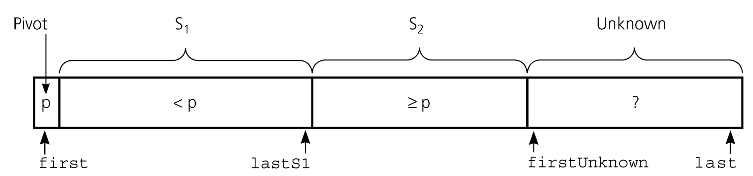
Partition Function (cont.)
Invariant for the partition algorithm

Slide 47
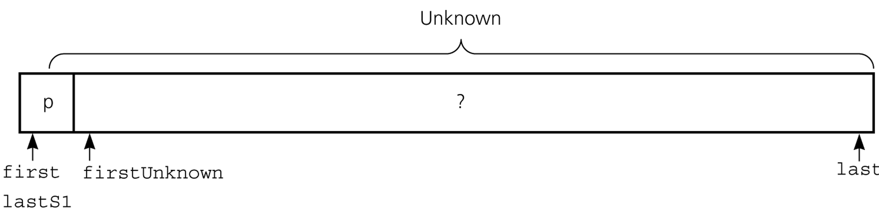
Partition Function (cont.)
Initial state of the array

Slide 48
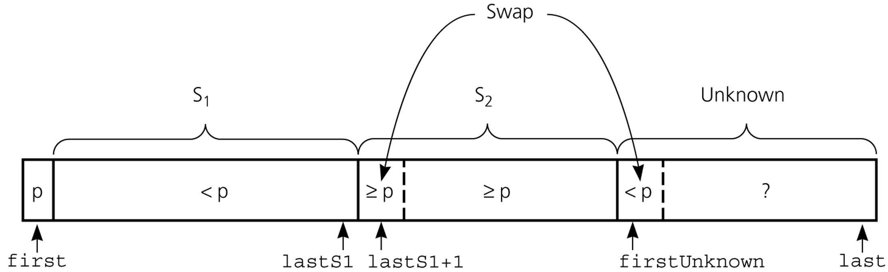
Partition Function (cont.)
Moving theArray[firstUnknown] into S₁ by swapping it with
theArray[lastS1+1] and by incrementing both lastS1 and firstUnknown.

Slide 49
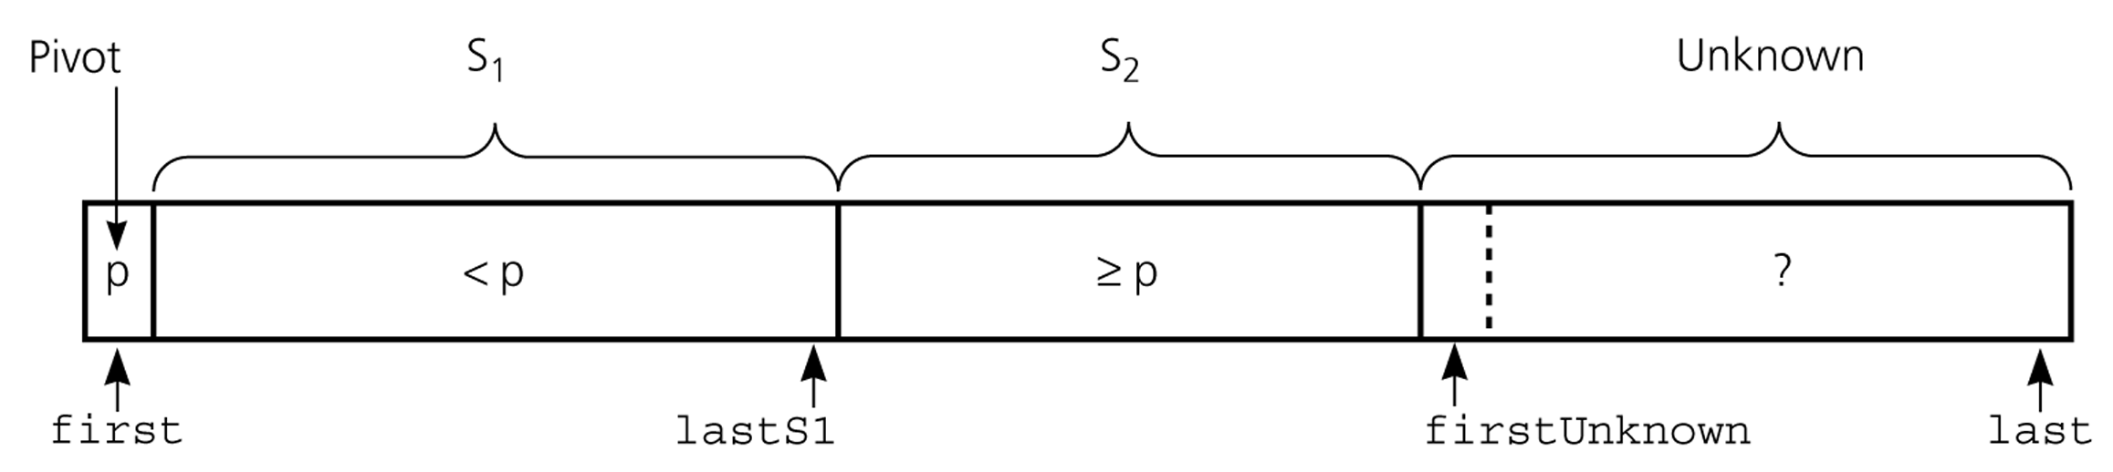
Partition Function (cont.)
Moving theArray[firstUnknown] into S₂ by incrementing firstUnknown.

Slide 50
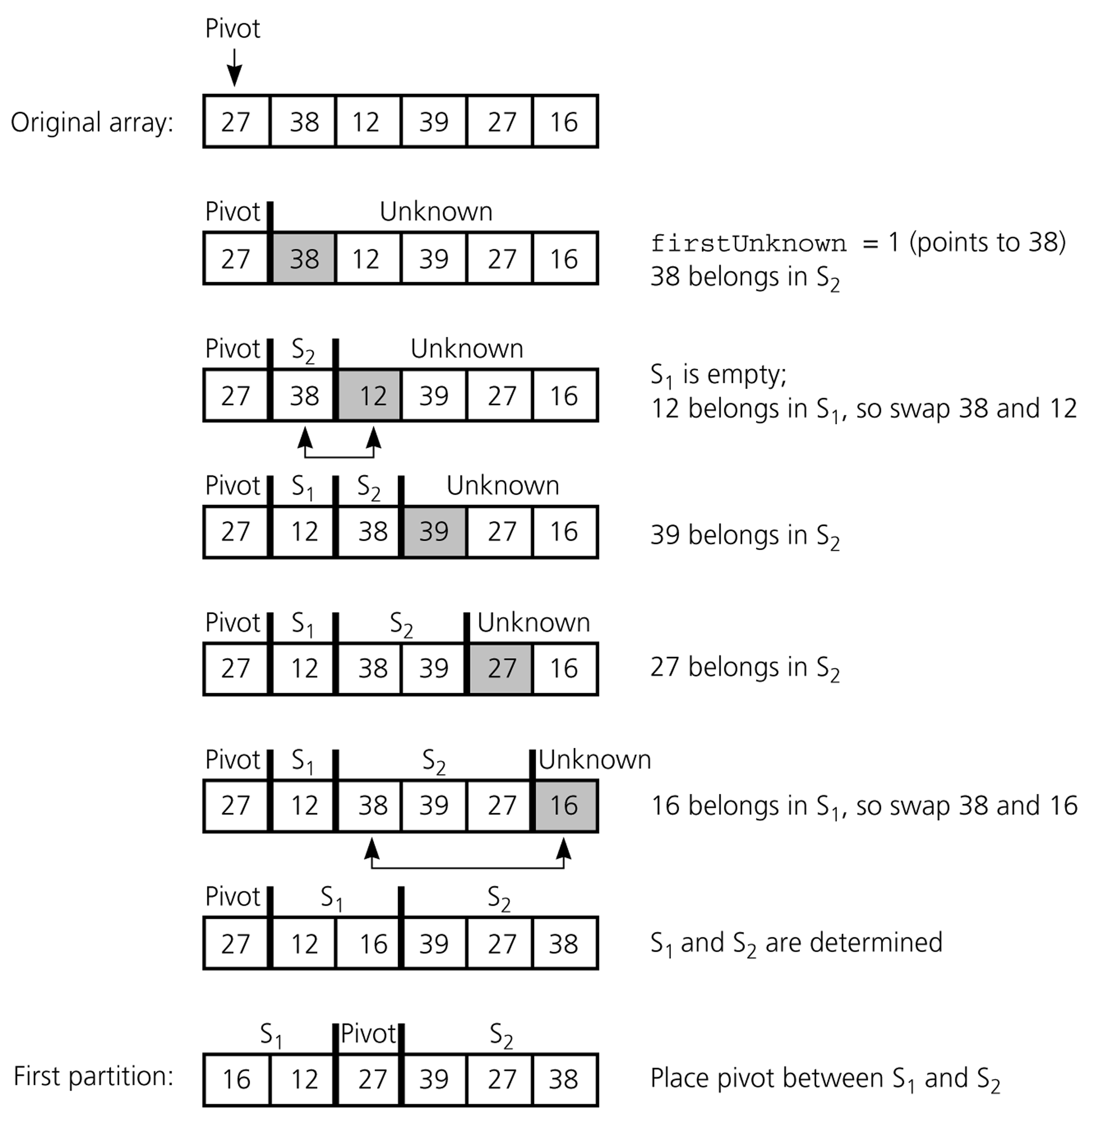
Partition Function (cont.)
Developing the first
partition of an array
when the pivot is the
first item

Slide 51
Quicksort Function
void quicksort(DataType theArray[], int first, int last) {
// Sorts the items in an array into ascending order.
// Precondition: theArray[first..last] is an array.
// Postcondition: theArray[first..last] is sorted.
// Calls: partition.
int pivotIndex;
if (first < last) {
// create the partition: S1, pivot, S2
partition(theArray, first, last, pivotIndex);
// sort regions S1 and S2
quicksort(theArray, first, pivotIndex-1);
quicksort(theArray, pivotIndex+1, last);
}
}

Slide 52
Quicksort – Analysis
Worst Case: (assume that we are selecting the first element as pivot)
The pivot divides the list of size n into two sublists of sizes 0 and n-1.
The number of key comparisons
= n-1 + n-2 + ... + 1
= n²/2 – n/2 ➔ O(n²)
The number of swaps =
= n-1 + n-1 + n-2 + ... + 1
swaps outside of the for loop swaps inside of the for loop
= n²/2 + n/2 - 1 ➔ O(n²)
So, Quicksort is O(n²) in worst case

Slide 53
Quicksort – Analysis
Quicksort is O(n*log₂n) in the best case and average case.
Quicksort is slow when the array is sorted and we choose the first element as the pivot.
Although the worst case behavior is not so good, its average case behavior is much better than its worst case.
So, Quicksort is one of best sorting algorithms using key comparisons.

Slide 54
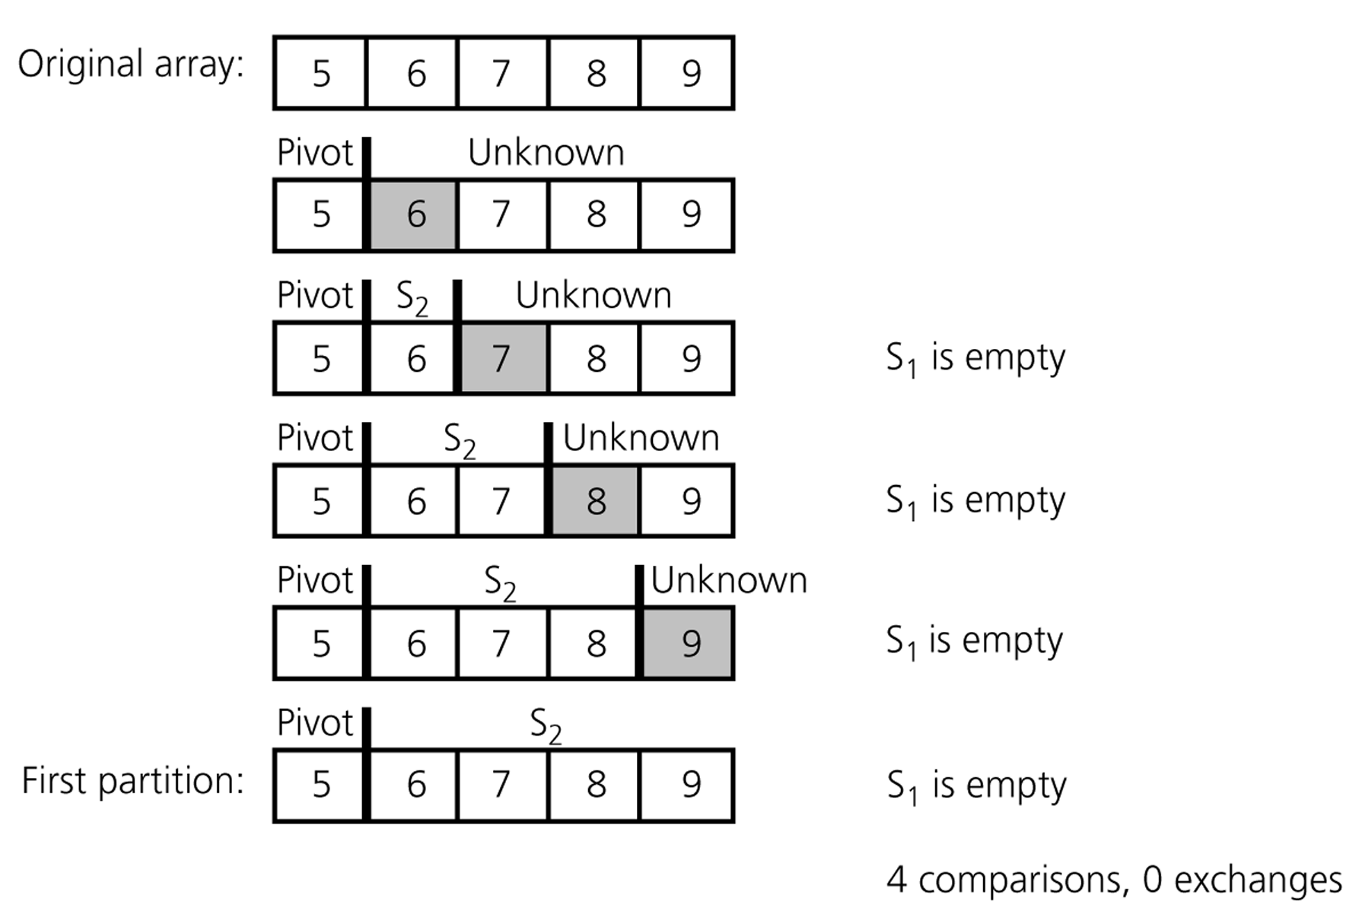
Quicksort – Analysis
A worst-case partitioning with quicksort

Slide 55
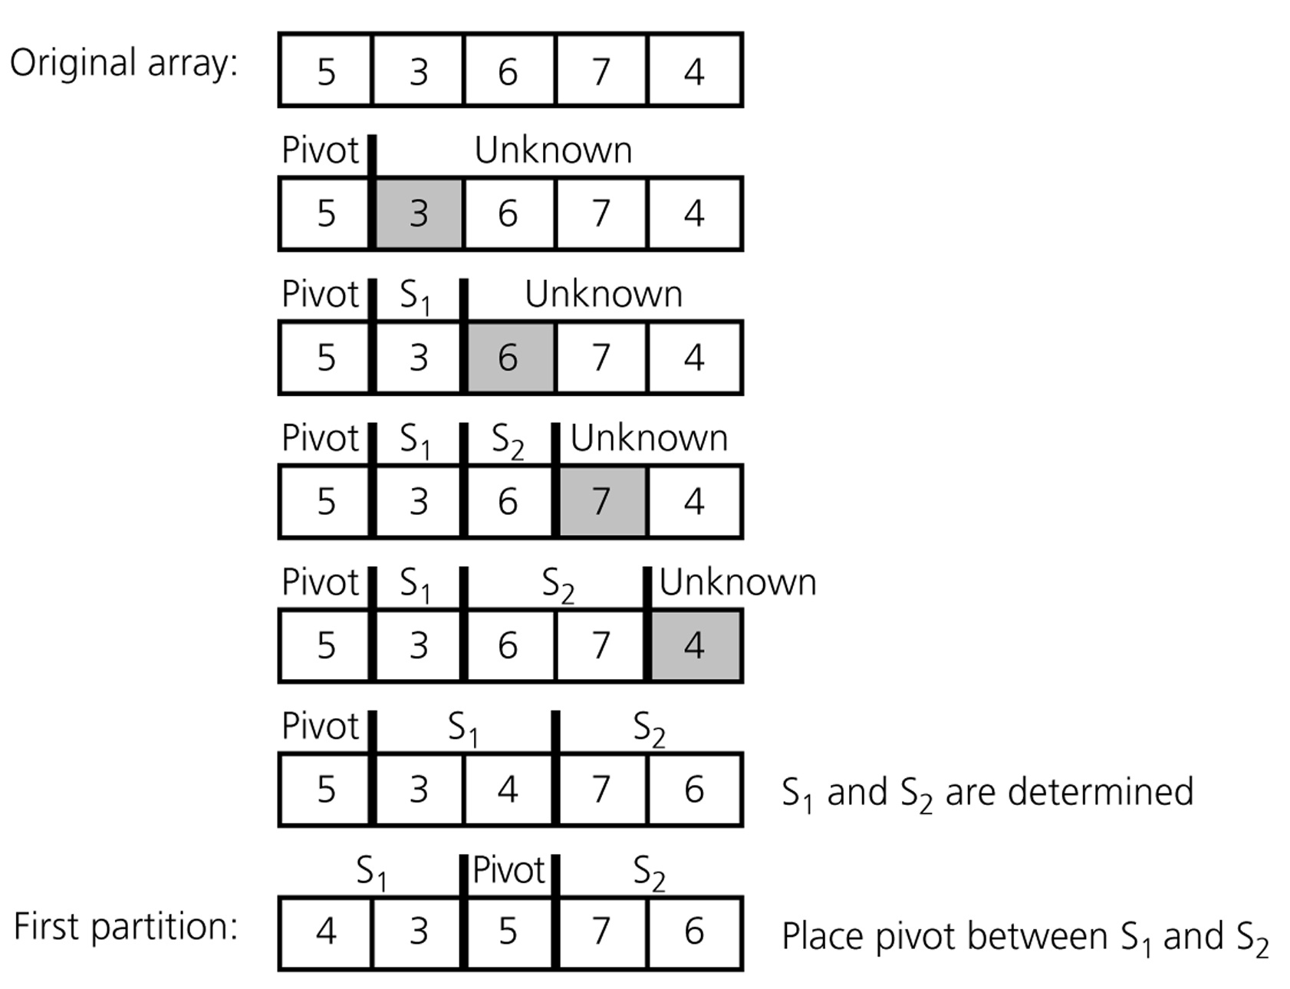
Quicksort – Analysis
An average-case partitioning with quicksort

Slide 56
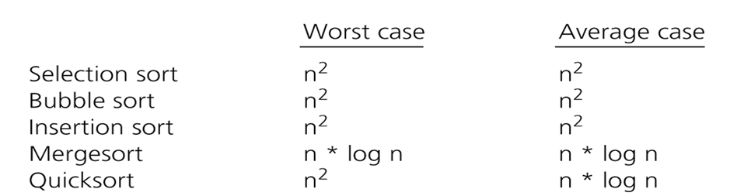
Comparison of Sorting Algorithms

Slide 57
Heap

Slide 58
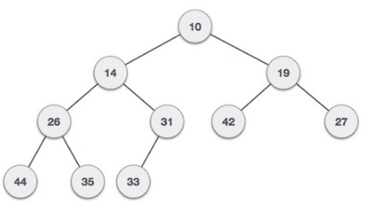
Heap
Heap is a special case of balanced binary tree data structure where root-node key is compared with its children and arranged accordingly. If α has child node β then −
key(α) ≥ key(β)
As the value of parent is greater than that of child, this property generatesMax Heap. Based on this criteria a heap can be of two types −
For Input → 35 33 42 10 14 19 27 44 26 31
Min-Heap − where the value of root node is less than or equal to either of its children.

Slide 59
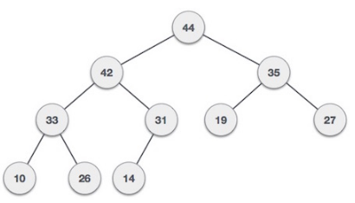
Max-Heap − where the value of root node is greater than or equal to either of its children.

Slide 60
Max Heap Construction
We are going to derive an algorithm for max-heap by inserting one element at a time. At any point of time, heap must maintain its property. While insertion, we also assume that we are inserting a node in already heapified tree.
Step 1 − Create a new node at the end of heap.
Step 2 − Assign new value to the node.
Step 3 − Compare the value of this child node with its parent.
Step 4 − If value of parent is less than child, then swap them.
Step 5 − Repeat step 3 & 4 until Heap property holds.
Note − In Min Heap construction algorithm we expect the value of parent node to be less than that of child node.
.

Slide 61
Let's understand Max Heap construction by an animated illustration. We take the same input sample that we use earlier.

Slide 62
Max Heap Deletion
Deletion in Max (or Min) Heap is always happen at the root to remove the Maximum (or minimum) value.
Step 1 − Remove root node.
Step 2 − Move the last element of last level to root.
Step 3 − Compare the value of this child node with its parent.
Step 4 − If value of parent is less than child, then swap them.
Step 5 − Repeat step 3 & 4 until Heap property holds.

Slide 63
Graph

Slide 64
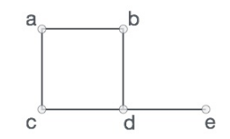
Graph
A graph is a pictorial representation of a set of objects where some pairs of objects are connected by links. The interconnected objects are represented by points termed as vertices, and the links that connect the vertices are called edges.
Formally, a graph is a pair of sets (V, E), where V is the set of vertices and E is the set of edges, connecting the pairs of vertices. Take a look at the following graph −
In the above graph,
V = {a, b, c, d, e}
E = {ab, ac, bd, cd, de}

Slide 65
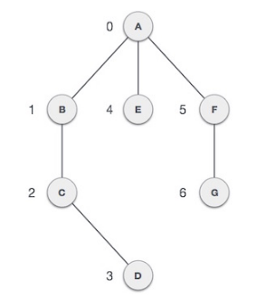
Mathematical graphs can be represented in data-structure. We can represent a graph using an array of vertices and a two dimensional array of edges. Before we proceed further, let's familiarize ourselves with some important terms −
Vertex − Each node of the graph is represented as a vertex. In example given below, labeled circle represents vertices. So A to G are vertices. We can represent them using an array as shown in image below. Here A can be identified by index 0. B can be identified using index 1 and so on.
Edge − Edge represents a path between two vertices or a line between two vertices. In example given below, lines from A to B, B to C and so on represents edges. We can use a two dimensional array to represent array as shown in image below. Here AB can be represented as 1 at row 0, column 1, BC as 1 at row 1, column 2 and so on, keeping other combinations as 0.
Adjacency − Two node or vertices are adjacent if they are connected to each other through an edge. In example given below, B is adjacent to A, C is adjacent to B and so on.
Path − Path represents a sequence of edges between two vertices. In example given below, ABCD represents a path from A to D.

Slide 66
Basic Operations
Following are basic primary operations of a Graph which are following.
Add Vertex − add a vertex to a graph.
Add Edge − add an edge between two vertices of a graph.
Display Vertex − display a vertex of a graph.
Graph and its representations
Graph is a data structure that consists of following two components: 1. A finite set of vertices also called as nodes. 2. A finite set of ordered pair of the form (u, v) called as edge. The pair is ordered because (u, v) is not same as (v, u) in case of directed graph(di-graph). The pair of form (u, v) indicates that there is an edge from vertex u to vertex v. The edges may contain weight/value/cost.

Slide 67
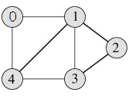
Graphs are used to represent many real life applications: Graphs are used to represent networks. The networks may include paths in a city or telephone network or circuit network. Graphs are also used in social networks like linkedIn, facebook. For example, in facebook, each person is represented with a vertex(or node). Each node is a structure and contains information like person id, name, gender and locale.
Following is an example undirected graph with 5 vertices.
Following two are the most commonly used representations of graph. 1. Adjacency Matrix 2. Adjacency List There are other representations also like, Incidence Matrix and Incidence List. The choice of the graph epresentation is situation specific. It totally depends on the type of operations to be performed and ease of use.

Slide 68
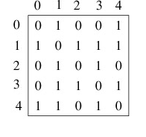
Adjacency Matrix: Adjacency Matrix is a 2D array of size V x V where V is the number of vertices in a graph. Let the 2D array be adj[][], a slot adj[i][j] = 1 indicates that there is an edge from vertex i to vertex j. Adjacency matrix for undirected graph is always symmetric. Adjacency Matrix is also used to represent weighted graphs. If adj[i][j] = w, then there is an edge from vertex i to vertex j with weight w.
The adjacency matrix for the above example graph is:
Pros: Representation is easier to implement and follow. Removing an edge takes O(1) time. Queries like whether there is an edge from vertex ‘u’ to vertex ‘v’ are efficient and can be done O(1).
Cons: Consumes more space O(V^2). Even if the graph is sparse(contains less number of edges), it consumes the same space. Adding a vertex is O(V^2) time.

Slide 69
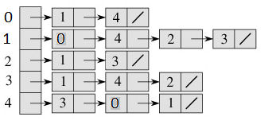
Adjacency List: An array of linked lists is used. Size of the array is equal to number of vertices. Let the array be array[]. An entry array[i] represents the linked list of vertices adjacent to the ith vertex. This representation can also be used to represent a weighted graph. The weights of edges can be stored in nodes of linked lists. Following is adjacency list representation of the above graph.
Pros: Saves space O(|V|+|E|) . In the worst case, there can be C(V, 2) number of edges in a graph thus consuming O(V^2) space. Adding a vertex is easier.
Cons: Queries like whether there is an edge from vertex u to vertex v are not efficient and can be done O(V).

Slide 70
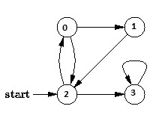
Breadth First Traversal for a Graph
Breadth First Traversal (or Search) for a graph is similar to Breadth First Traversal of a tree. The only catch here is, unlike trees, graphs may contain cycles, so we may come to the same node again. To avoid processing a node more than once, we use a boolean visited array. For simplicity, it is assumed that all vertices are reachable from the starting vertex.
For example, in the following graph, we start traversal from vertex 2. When we come to vertex 0, we look for all adjacent vertices of it. 2 is also an adjacent vertex of 0. If we don’t mark visited vertices, then 2 will be processed again and it will become a non-terminating process. A Breadth First Traversal of the following graph is 2, 0, 3, 1.

Slide 71
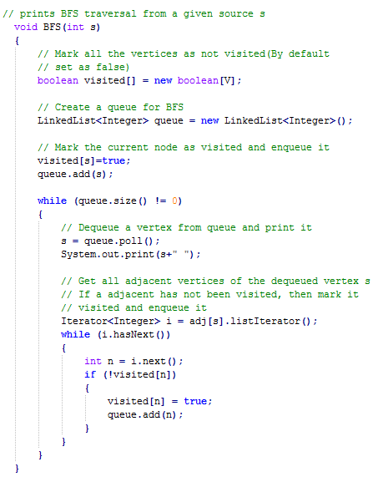
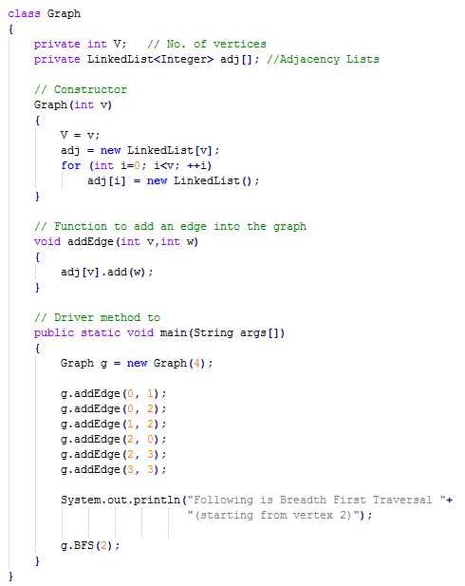
Following is the implementations of simple Breadth First Traversal from a given source.

Slide 72
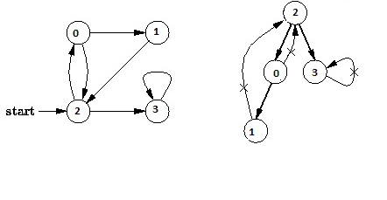
Depth First Traversal for a Graph
Depth First Traversal (or Search) for a graph is similar to Depth First Traversal of a tree. The only catch here is, unlike trees, graphs may contain cycles, so we may come to the same node again. To avoid processing a node more than once, we use a boolean visited array.
For example, in the following graph, we start traversal from vertex 2. When we come to vertex 0, we look for all adjacent vertices of it. 2 is also an adjacent vertex of 0. If we don’t mark visited vertices, then 2 will be processed again and it will become a non-terminating process. A Depth First Traversal of the following graph is 2, 0, 1, 3.

Slide 73
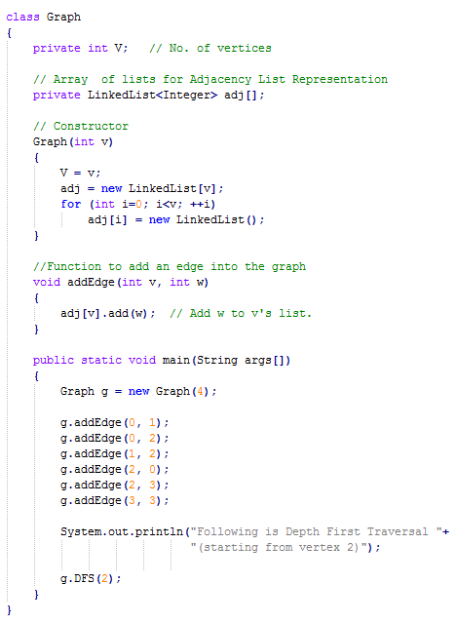
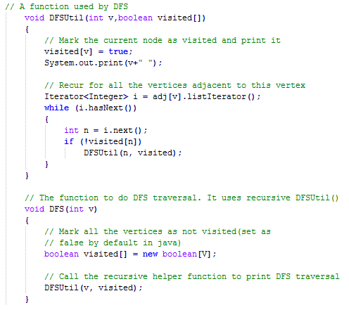
Following is the implementations of simple Depth First Traversal.

Slide 74
Recap
Binary Search Tree
Searching a key
Inserting a key
Deleting a key
Sorting Algorithms
Selection Sort
Insertion Sort
Bubble Sort
Merge Sort
Quick Sort
Heap
Max Heap Construction
Max Heap Deletion
Graph
Breadth First Traversal
Depth First Traversal

Slide 75
References
http://www.geeksforgeeks.org/data-structures/
http://www.tutorialspoint.com/data_structures_algorithms/

Slide 76
THANK YOU

